Slide 1
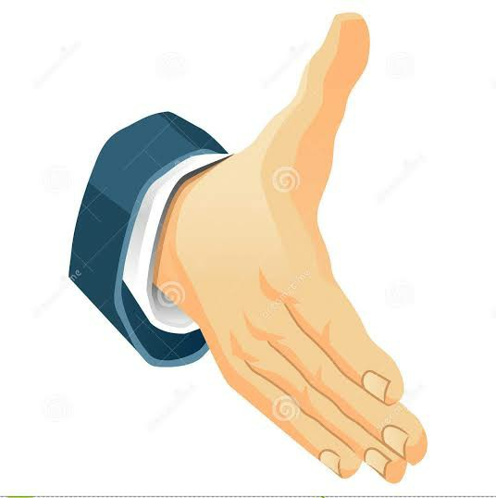

ATOMIC ENERGY EDUCATION SOCIETY, MUMBAI.
Module-1/3 W WELCOME

Slide 2
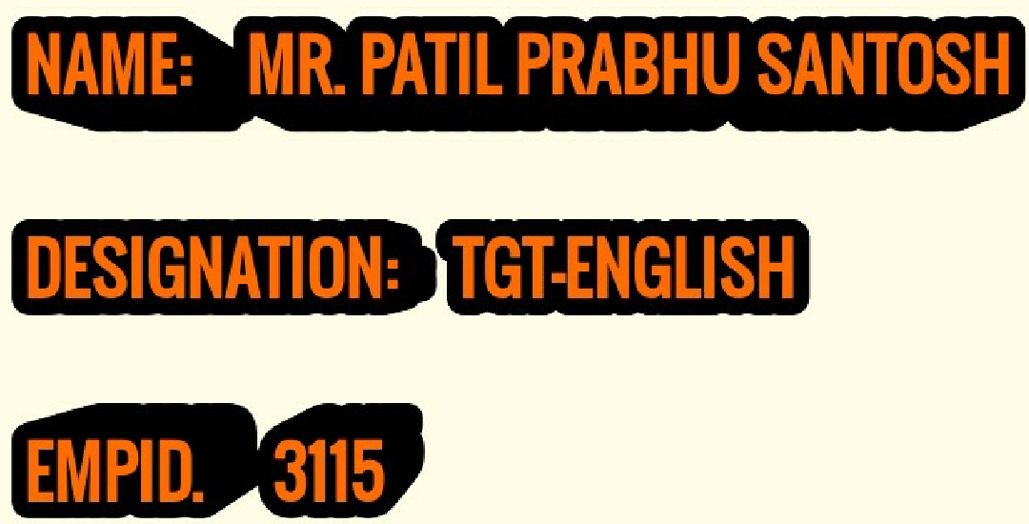
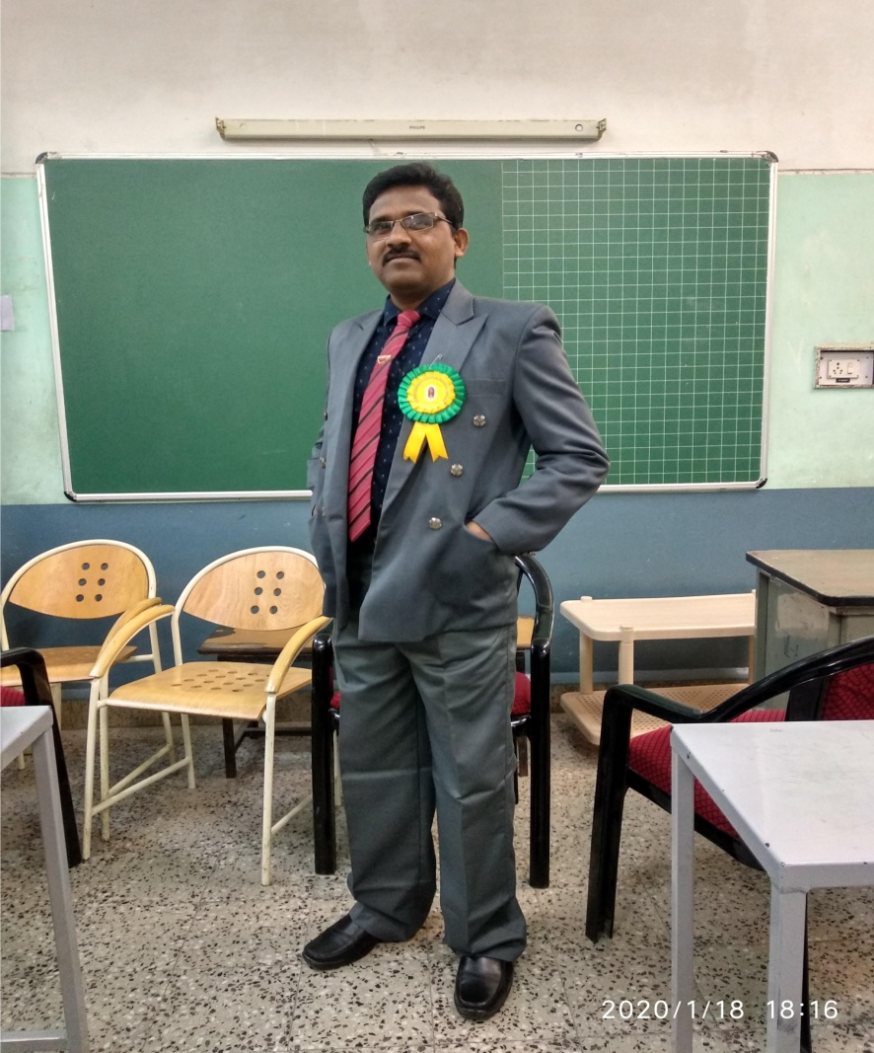
FROM:
ATOMIC ENERGY CENTRAL SCHOOL, INDORE

Slide 3
Content:
1) Title of the story
2) Biography of the writer
3) Introduction of the story
4) Major Characters:
i) Happy Prince:
ii) The Swallow:
5) Minor Characters:
i) The Seamstress
ii) The young Playwright
iii) The Little Girl
iv) Mayor of the town and councillors
v) The Angel

Slide 4
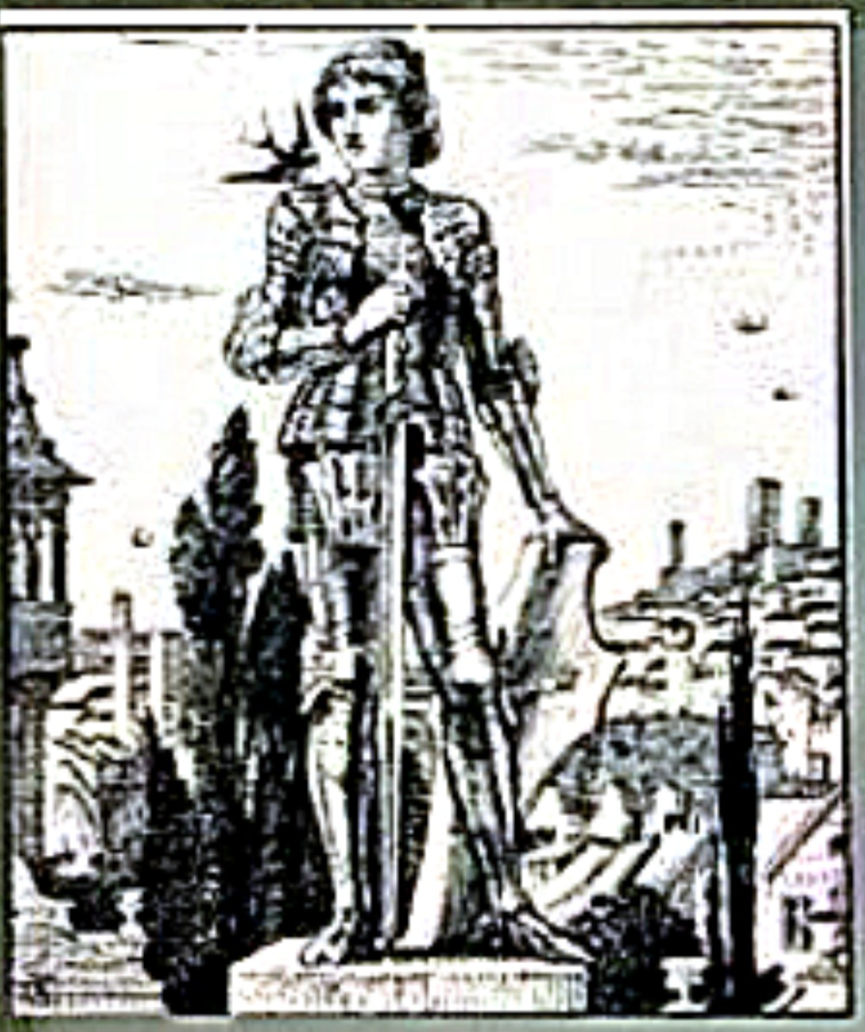
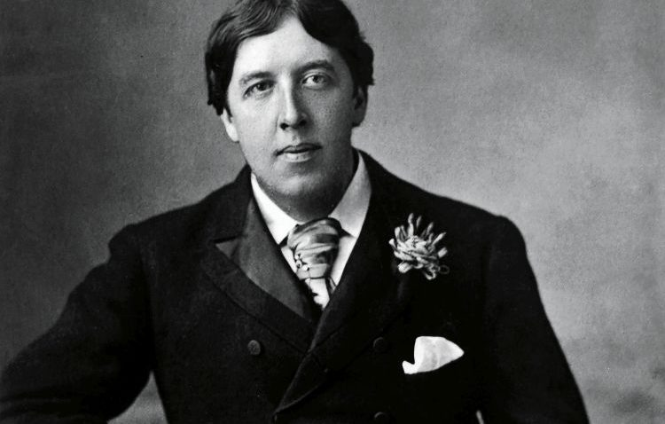
Class: IX
MOMENTS:
The Happy Prince
By- Oscar Wilde

Slide 5
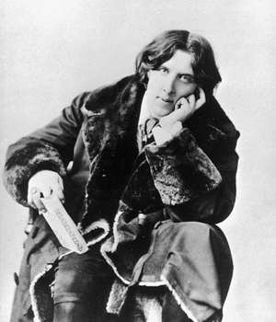
BIOGRAPHY OF THE WRITER:
Oscar Wilde
*Born: October 16, 1854- Dublin, Ireland.
*Died: November 30, 1900 (aged 46)- Paris, France.
He was an Anglo-Irish playwright, novelist, poet, and critic.
He is regarded as one of the greatest playwrights of the Victorian Era.
In his lifetime he wrote nine plays, one novel, and numerous poems, short stories, and essays.
He was also known for his wit and his flamboyance.
A great thinker, aesthetic, notorious figure in society and respected man of letters.
He is known for introducing the principle of “arts for art’s sake” and “beauty for beauty’s sake”.
His interest in religious matters and themes are visible in his collections of short stories in which he emphasizes the theme of sacrifice, mercy and kindness.

Slide 6
Major Characters:
*Happy Prince:
This is the central character in the story.
Lived happily as born in royal family.
Never knew sadness or miseries throughout his life.
Became familiar with poverty and sufferings in life in the form of ‘statue’.
Achieved place in the Paradise by showing his charity and kindness towards the miseries of the people.
*The Swallow:
This is the second major character in the story.
This bird gains the purpose of life in the company of the prince.
Worked as a messenger for the statue of the happy prince.
The helping and caring nature of the bird leads to transformation in its character.
Became precious to the God due to its loving and helping nature.

Slide 7
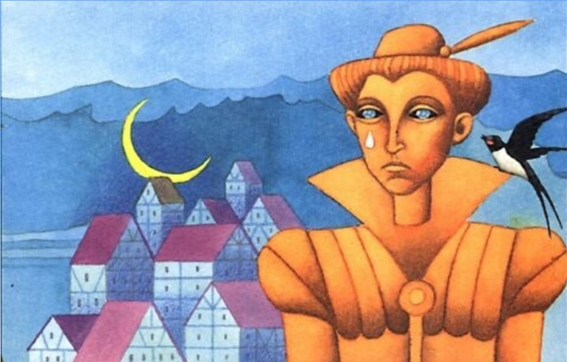
Introduction of the story:
“The Happy Prince”
Oscar Wilde became the editor of Woman’s World (1887–89). During this period of apprenticeship as a writer, he published The Happy Prince and Other Tales (1888), which reveals his gift for romantic allegory in the form of the fairy tale.
This story is about a Prince. When the prince was alive, he was very happy. A big statue of the prince was erected on a pedestal after his death. From there, the statue of the Prince could see the entire city and at that time he saw the miseries of the people. He saw the poor people, the homeless, their hunger, and starvation. The Prince became sad when he saw all these miseries of the people. The statue of the Happy Prince was covered with gold and many fine jewels. One day, a swallow passing through seeks shelter under the statue and discovers the prince is not happy, but sad.
Thus, the story of the Happy Prince is ‘ironical’.

Slide 8

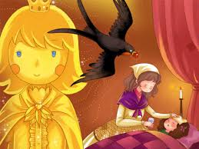
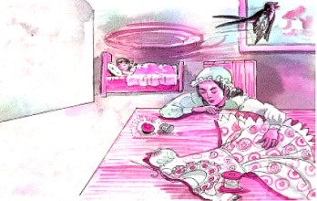
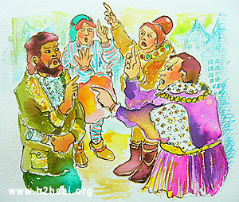
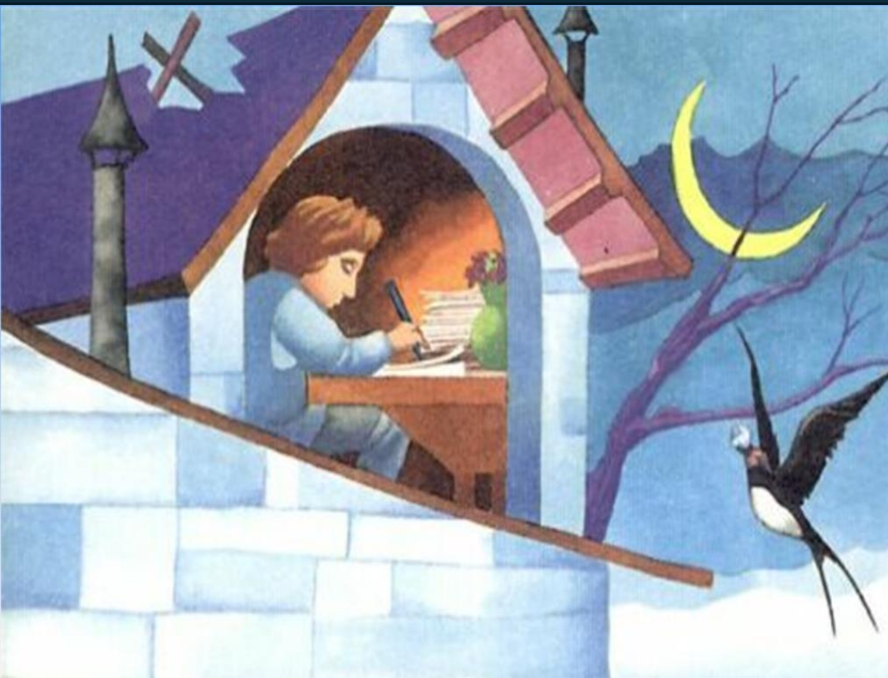
Minor Characters-
*The Seamstress:
Unfortunately, all her matchsticks are spoiled which were to be sold.
She was afraid of her father, for if she went at home penniless will be beaten.
She is helped by the prince offering her his second eye i.e. sapphire.
*Mayor of the town and councillors:
They all are greedy and obsessed with publicity.
All are indifferent to the humanity of the prince and the swallow.
They are busy in their money, rank and power.
*The Little Girl:
She is the first poor noticed and helped with ruby by the statue of the prince.
She is described as a thin and worn face woman.
She struggles as a seamstress to make enough money to look after her son.
----------------------------------------------*The young Playwright:
He is an emerging poor playwright.
Described as starving and suffering from cold, so faints.
His hope as a playwright is blazed with the help in the form of sapphire by the prince. He thinks that he is recognised by the admirer.

Slide 9
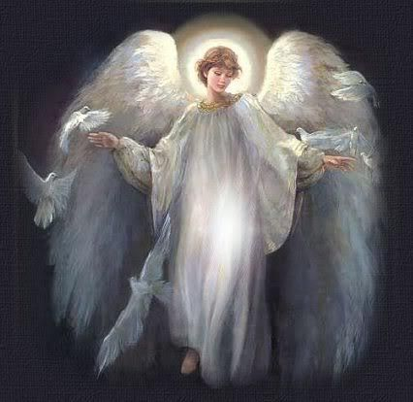
*The Angel:
The angel is the messenger of the God, whom the task of bringing two most precious things in the city was given.
The angel proved to be worthy of God’s messenger by bringing the leaden heart of the prince and the dead swallow. They were the perfect example of true friendship, kindness, love and affection.

Slide 10
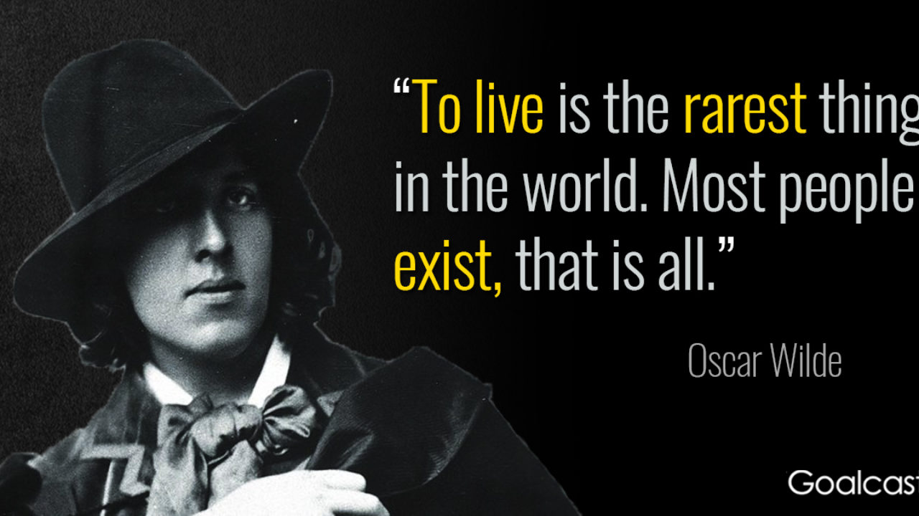

Slide 11


